Slide 2

.NET Framework

Slide 3
Common Type System
The common type system defines how types are declared, used, and managed in the runtime.
Establishes a framework that enables cross-language integration, type safety, and high performance code
Provides an object-oriented model that supports the complete implementation of many programming languages
The common type system supports two types
Value Types
Reference Types
Type
Value types
Reference types
Built-in value types
Self-describing types
Pointer types
Interface types
User-defined value types
Enumerations
Class types
Arrays
Self-describing types
Pointer types
Interface types

Slide 4
Differences
Value types:
Reference Type
Directly contain their data
Each has its own copy of data
Operations on one cannot affect another
Store references to their data(known as objects)
Two reference variables can reference same object
Operations on one can affect another
System. Int32 myInt – 42;
System. String myString = “Hello, World”;
Heap
myInt
42
myString
“Hello, World”

Slide 5
Value Type
Value Types
Built-in-Type
User-Defined
Examples of built-in value types:
Examples of user-defined value types:
int
float
enum
struct

Slide 6
Primitive Data Types
Data type | Description | Size (bits) | [*]Range | Simple Usage
Int | Whole numbers | 32 | <->2³¹ through 2³¹ <->1 | int count; count = 42
long | Whole numbers(bigger range) | 64 | <->2⁶³ through 2⁶³ <->1 | long wait; wait = 42L;
float | Floating-point | 32 | + 3.4 * 10³⁸ | float away; away = 0.42F
double | Double precision(more accurate) floating-point numbers | 64 | + 1.7 * 10³⁰⁸ | double trouble; trouble = 0.42
Decimal | Monetary values | 128 | 28 significant figures | decimal coin; coin = 0.24M;
String | Sequence of characters | 16 bits per character | Not applicable | string vest; vest = “42”;
Char | Single character | 16 | 0 through 216 <-> 1 | Char grill; grill = “4”
Bool | Boolean | 8 | True or false | Bool teeth; teeth= false
[*] The value of 216 is 32,768; the value of 231 is 2,147,463,648; and the value of 263 is 9,233,372,036,854,775,808.

Slide 7
Predefined data Types
Value types : stores its value directly in memory, in an area known as the “stack”. For example, int which means that the following statement will result in two locations in
memory storing the value 20
// i and j are both of type int
i = 20;
j = I;

Slide 8
Predefined data Types
Reference types : stores a reference to the value in memory , in an area known as the “managed heap”.
Ex: Vector x, y;
x = new Vector();
x.Value = 30; // Value is a field defined in Vector class
y = x;
Console.WriteLine(y.Value); //30
y.Value = 50;
Console.WriteLine(x.Value);//50

Slide 9
Predefined data Types
Reference types :
If a variable is a reference, it is possible to indicate that it does not refer to any object by setting its value
to null :
y = null;

Slide 10
Predefined Value Types
Integer Types:
Name | CTS Type | Description | Range (MIN:Max)
Sbyte | System . SByte | 8-bit signed integer | -128:127 (-2⁷ :2⁷ -1 )
Short | System . Int 16 | 16-bit signed integer | -32,768:32,767(-2¹⁵ :2¹⁵ -1 )
Int | System . Int 32 | 32-bit signed integer | -2,147,483,648:2,147,483,647 (-2³¹ :2³¹ -1 )
Long | System . Int 64 | 64-bit signed integer | -9,223,372,036,854,775,808: 9,223,372,036,854,775,807(-2⁶³ :26³ -1 )
Byte | System . Byte | 8-bit signed integer | 0:255 (0.2⁸ - 1)
Ushort | System .Uint 16 | 16-bit signed integer | 0:255(0:2⁸ -1 )
Uint | System . Uint 32 | 32-bit signed integer | 0:65,535(0:2¹⁶ -1 )
ulong | System . Uint 64 | 64-bit signed integer | 0:18,446,744,073,709,551,615 (0:2⁶⁴ -1 )

Slide 11
Predefined Value Types
Integer Types cont.:
With .NET, a short is no longer quite so short; it is now 16 bits long.
The int type is 32 bits long. The
long type reserves 64 bits for values. All integer-type variables can be assigned values in
decimal or in hex notation. The latter requires the 0x prefix:
long x = 0x12ab;
If there is any ambiguity about whether an integer is int, uint, long, or ulong
, it will default to an int.
To specify which of the other integer types the value should take,
you can append one of the following
characters to the number:
uint ui = 1234U;
long l = 1234L;
ulong ul = 1234UL;
You can also use lowercase u and l,
although the latter could be confused with the integer 1 (one).

Slide 12
Predefined Value Types
floating-Point Types:
Name | CTS Type | Description | Figures | Range (APPROXIMATE)
float | System . Single | 32-bit single-precision floating point | 7 | ±1.5 x 10²⁴⁵ to ± 304 x 10 ³⁸
double | System . Double | 64-bit double-precision floating point | 15/16 | ±1.7 x 10³⁰⁸ to ± 1.7 x 10 ³⁰⁸
The float data type is for smaller floating-point values, for which less precision is required. The double data type is bulkier than the float data type but offers twice the precision (15 digits).
If you hard-code a non-integer number (such as 12.3) in your code, the compiler will normally assume that you want the number interpreted as a double. If you want to specify that the value is a float, you append the character F (or f) to it:
float f = 12.3F;

Slide 13
Predefined Value Types
Decimal Type:
Name | CTS Type | Description | Significant Figures | Range (APPROXIMATE)
Decimal | System . Decimal | 128-bit high-precision floating notation | 28 | ±1.0 x 10²²⁸ to ± 7.9 x 10²⁸
To specify that your number is a decimal type rather than a double, float, or an integer, you can append the M (or m) character to the value, as shown in the following example:
decimal d = 12.30M;

Slide 14
Predefined Value Types
Boolean Type:
Name | CTS Type | Description | Significant Figures | Range (APPROXIMATE)
Bool | System . Boolean | Represents true or false | NA | True or false
You cannot implicitly convert bool values to and from integer values.
If a variable (or a function return type) is declared as a bool, you can only use values of true and false. You will get an error if you try to use zero for false and a non-zero value for true.

Slide 15
Predefined Value Types
Character Type:
Name | CTS Type | Description
Char | System . Char | Represents a single 16-bit (Unicode) character
Literals of type char are signified by being enclosed in single quotation marks,
for example ‘A’.
If you try to enclose a character in double quotation marks,
the compiler will treat this as a string and throw
an error.

Slide 16
Predefined reference Types
object and string,:
Name | CTS Type | Description
Object | System . Object | The root type. All other types in the CTS are derived (including value types) from object.
String | System . String | Unicode charcter string
The object Type :
a root type, we will study it later..!
The string type:
string str1 = "Hello ";
string str2 = "World";
string str3 = str1 + str2; // string concatenation

Slide 17
Predefined reference Types
The string type cont.:
using System;
class StringExample
{
public static int Main()
{
string s1 = "a string";
string s2 = s1;
Console.WriteLine("s1 is " + s1);
Console.WriteLine("s2 is " + s2);
s1 = "another string";
Console.WriteLine("s1 is now " + s1);
Console.WriteLine("s2 is now " + s2);
return 0;
}
}
s1 is a string
s2 is a string
s1 is now another string
s2 is now a string

Slide 18
Predefined reference Types cont.
The string type cont.:
string filepath = "C:\\DotNETClub\\First.cs";
string filepath = @"C:\ DotNETClub \First.cs";
string jabberwocky = @“’Hi for All
How are you?.";
OUT
' Hi for All
How are you?.

Slide 19
Access Modifiers
public
Signifies that the member is accessible from outside the class’s definition and hierarchy of derived classes. A class is the encapsulation of data and the methods that work on that data
protected
The member is not visible outside the class and can be accessed by derived classes only.
private
The member cannot be accessed outside the scope of the defining class. Therefore, not even derived classes have access to these members.
internal
The member is visible only within the current compilation unit. The internal access modifier creates a hybrid of public and protected accessibility depending on where the code resides.

Slide 20
Methods
A method is a named sequence of statements
Method is Functionality member of a Class
The Syntax of a method is
[modifiers] return_type MethodName([parameters]) { // Method body }
Name
You cannot give a method the same name as a variable, a constant, or any other non-method item declared in the class. The method name can be any allowable C# identifier, and it is case sensitive.
Parameter list
The method name is followed by a parameter list for the method. This is enclosed between parentheses. The parentheses must be supplied even if there are no parameters, as is shown in the examples on the slide.
Body of the method
Following the parentheses is the body of the method. You must enclose the method body within braces ({ and }), even if there is only one statement.

Slide 21
Calling Methods
Call a method from within the same class
Use method’s name followed by a parameter list in
parentheses
Call a method that is in a different class
You must indicate to the compiler which class contains
the method to call The called method must be declared with the public keyword
Methods can call methods, which can call other
methods, and so on

Slide 22
Example:
class C {
int sum = 0, n = 0;
public void Add (int x) { // procedure
sum = sum + x; n++;
}
public float Mean() { // function (must return a value)
return (float)sum / n;
}
Access from class C:
Add(3);
float x = Mean();
Access from other classes
C c = new C();
c.Add(3);
float x = c.Mean();

Slide 23
Return Statement
Every method should return the type mentioned in the signature
class Test
{ public int ReturnCount(int a,int b) {
int c = a+b; return c;
}
}
If don’t want return any thing mention void for return type in definition
class A
{
public static void TestMethod( )
{
Console.WriteLine("This is TestMethod in class A");
}
}
By default, a method returns to its caller when the end of the last statement in the code block is reached. If you want a method to return immediately to the caller, use the return statement.

Slide 24
Local Variables
Private to the method
Destroyed on exit
No access modifiers
Class variables are used for sharing also know as shared variables
Compiler will not warn if local and class names clash

Slide 25
Using Parameters
Place between parentheses after method name
Define type and name for each parameter
static void MethodWithParameters(int n, string y)
{ ... }
Supply a value for each parameter
MethodWithParameters(2, "Hello, world");

Slide 26
Passing Parameters
By value
Value parameters are sometimes called in parameters because data can be transferred into the method but cannot be transferred out.
By reference
Reference parameters are sometimes called in/out parameters because data can be transferred into the method and out again.
By output
Output parameters are sometimes called out parameters because data can be transferred out of the method but cannot be transferred in.

Slide 27
By Value
Default mechanism for passing parameters:
Variable can be changed inside the method
Has no effect on value outside the method
Parameter must be of the same type or compatible type
public void AddOne(int x)
{
x++; // Increment x
}
static void Main( )
{
int k = 6;
AddOne(k);
Console.WriteLine(k); // Display the value 6, not 7
}

Slide 28
Pass by Reference
A reference to memory location
Use the ref keyword in method declaration and call
Match types and variable values
Changes made in the method affect the caller
Assign parameter value before calling the method
Can pass both value and ref parameters in single method
public void AddOne(ref int x)
{
x++;
}
static void Main( )
{
int k = 6;
AddOne(ref k);
Console.WriteLine(k); // Display the value 7
}

Slide 29
Output Parameters
Similar to Ref parameters .
There is no need to be initialize
Notes:
Smir

Slide 30
Variable parameters
Use the params keyword
Declare as an array at the end of the parameter list
Always pass by value
static long AddList(params long[ ] v)
{ long total, i;
for (i = 0, total = 0; i < v.Length; i++)
total += v[i]; return total;
}
static void Main( )
{
long x = AddList(63,21,84);
}

Slide 31
Overloaded Methods
Methods cannot not have the same name as other non-method items in a class
However, it is possible for two or more methods in a class to share the same
name.
Name sharing among methods is called overloading.
By Changing the method Signature – I.e –Changing the parameters by type or Number
Changing the return type is not overloading
class OverloadingExample
{ static int Add(int a, int b)
{ return a + b;
}
static int Add(int a, int b, int c)
{ return a + b + c;
} static void Main( )
{ Console.WriteLine(Add(1,2) + Add(1,2,3));
} }

Slide 32
Arrays
An array is a sequence of elements
All elements in an array have the same type
Individual elements are accessed using integer indexes
Integer index 0
(Zero)
Integer index 4
(four)

Slide 33
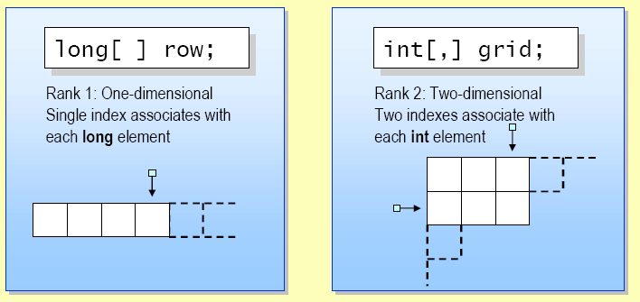
Array Declaration
You declare an array variable by specifying:
You do not specify the size of the array when declaring an array variable.
Rank is also known as the array dimension
The number of indexes associated with each element.

Slide 34
Creating Array Instances
Declaring an array variable does not create an array!
You must use new to explicitly create the array instance
Array elements have an implicit default value of zero

Slide 35
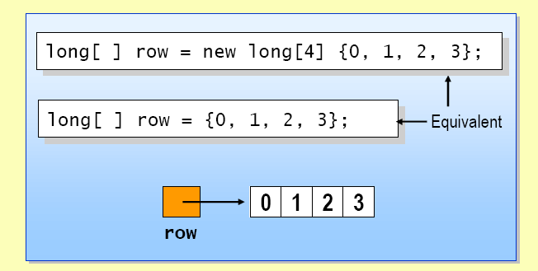
Initializing
The elements of an array can be explicitly initialized
You can use a convenient shorthand

Slide 36
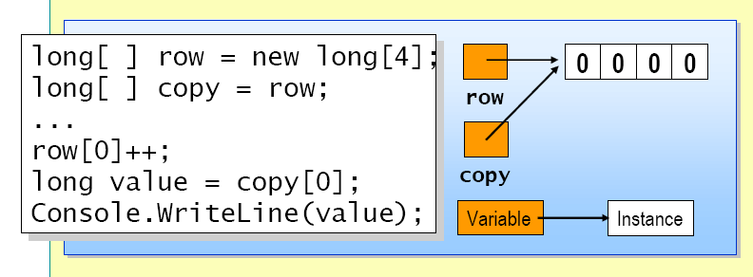
Copying Array Variables
Copying an array variable copies the array variable only
It does not copy the array instance
Two array variables can refer to the same array instance

Slide 37
Commonly used methods
Commonly used methods
Sort – sorts the elements in an array of rank 1
Clear – sets a range of elements to zero or null
Clone – creates a copy of the array
Get Length – returns the length of a given dimension
Index Of – returns the index of the first occurrence of a value

Slide 38
Enum
An Enum is a named constant underlying type is any integral type except Char
Enum Syntax: enum color { Red,Green ,Blue};
Using Enum : color colorPallete = color.Red
The default underlying type of the enumeration elements is int. By default, the first enumerator has the value 0, and the value of each successive enumerator is increased by 1.
enum Days {Sat=1, Sun, Mon, Tue, Wed, Thu, Fri}; In this enumeration, the sequence of elements is forced to start from 1 instead of 0.
enum Days {Sat=1, Sun, Mon, Tue, Wed, Thu, Fri}; In this enumeration, the sequence of elements is forced to start from 1 instead of 0.
int x = (int)DaysSun;Setting base type option as long
enum range : long{Max=2189900000;min=1000000}

Slide 39
Enumerations
An enumeration is a user-defined integer type.
public enum TimeOfDay
{
Morning = 0,
Afternoon = 1,
Evening = 2
}

Slide 40
Enumerations cont.
class EnumExample
{ public static int Main()
{ WriteGreeting(TimeOfDay.Morning);
return 0;
}
static void WriteGreeting(TimeOfDay timeOfDay){
switch(timeOfDay)
{ case TimeOfDay.Morning:
Console.WriteLine("Good morning!");
break;
case TimeOfDay.Afternoon:
Console.WriteLine("Good afternoon!");
break;
case TimeOfDay.Evening:
Console.WriteLine("Good evening!");
break;
default:
Console.WriteLine("Hello!"); break;
}}}

Slide 41
Enumerations cont.
You can retrieve the string representation of an enum as in the following example, using the earlier
TimeOfDay enum:
TimeOfDay time = TimeOfDay.Afternoon;
Console.WriteLine(time.ToString());
This will return the string Afternoon.
Alternatively, you can obtain an enum value from a string:
TimeOfDay time2 = (TimeOfDay) Enum.Parse(typeof(TimeOfDay), "afternoon", true);
Console.WriteLine((int)time2);

Slide 42
THANK YOU

